Slide 1









Pizza Order Details Analysis SQL

Slide 2



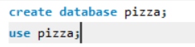


About Our Pizza Order Details
We have four csv files which include pizzas, pizza types, orders and orders details. To export the datasets, we first created a database and export these four files as tables.
To implement and analysis , we used MySQL workbench.

Slide 3

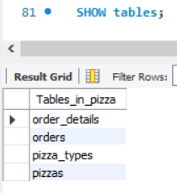



All the tables

Slide 4

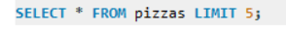
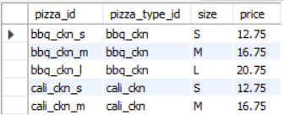
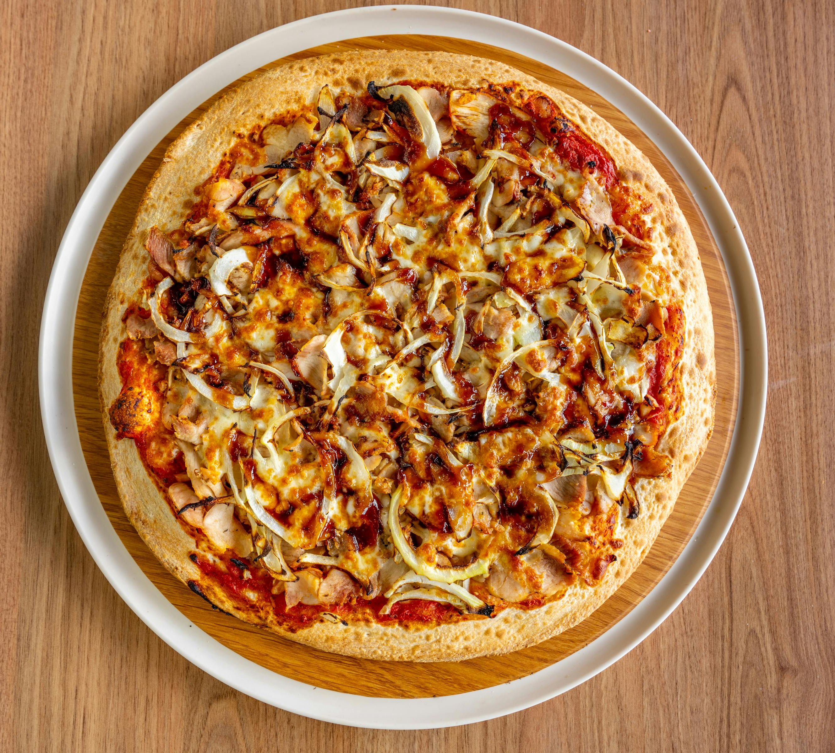
Sample Dataset

Slide 5

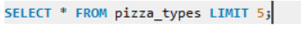
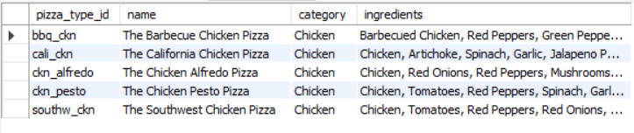

Sample Dataset

Slide 6
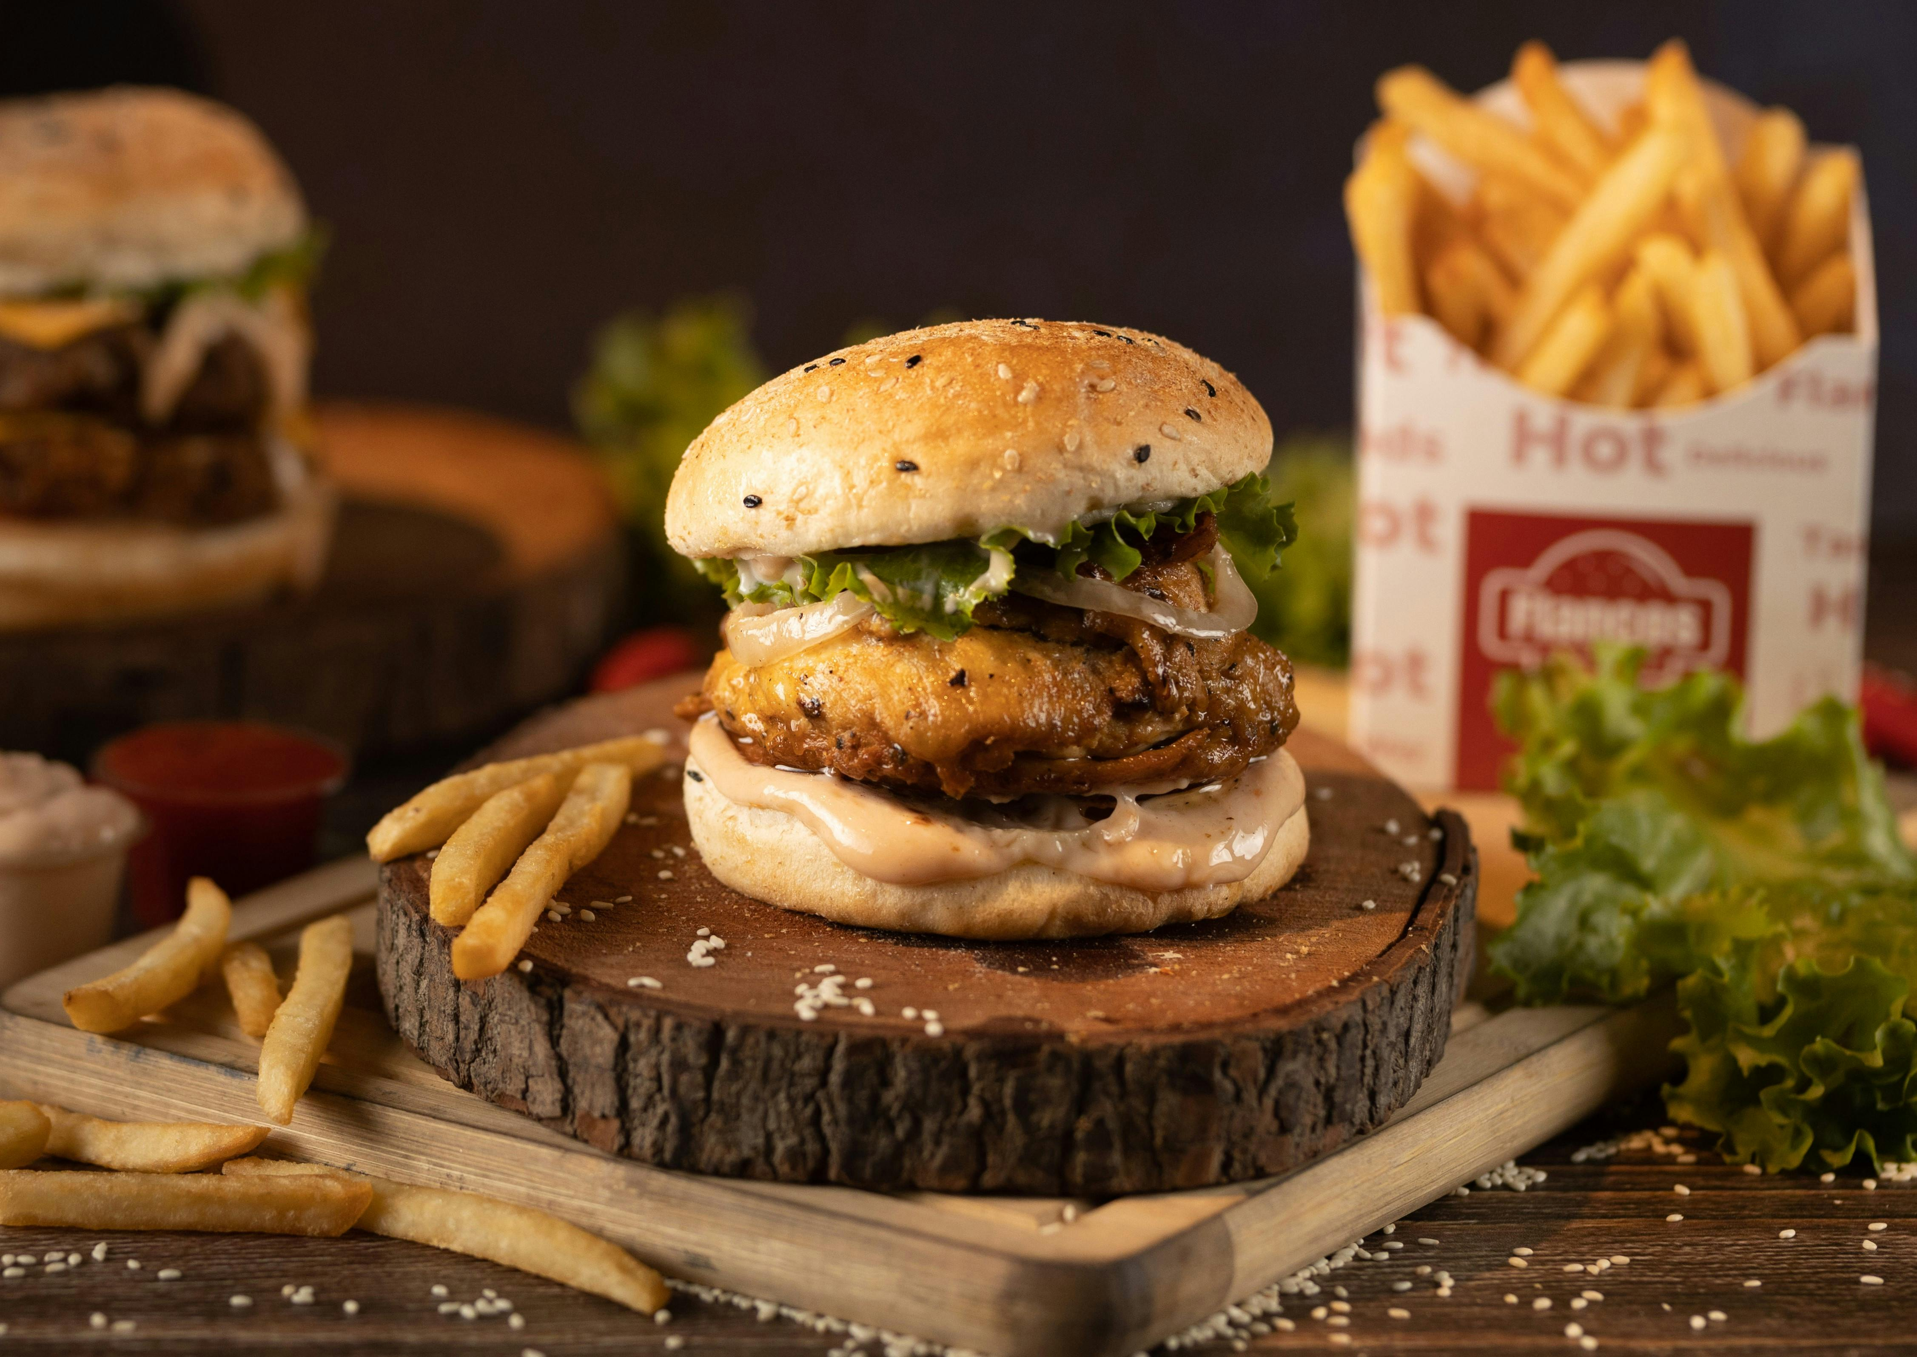
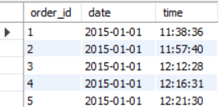

Sample Dataset

Slide 7
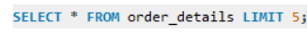
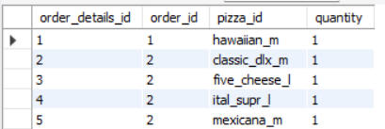
Sample Dataset

Slide 8

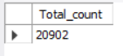
Some Analytical Queries
Retrieve the total number of orders placed.

Slide 9
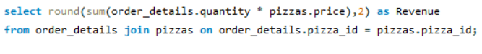
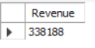
Some Analytical Queries
Calculate the total revenue generated from pizza sales.

Slide 10
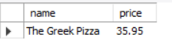
Some Analytical Queries
Identify the highest-priced pizza

Slide 11
Some Analytical Queries
Identify the most common pizza size ordered.
Size | Total_order
L | 7674

Slide 12
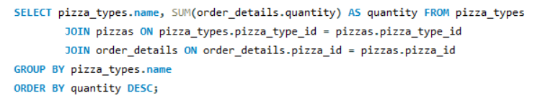
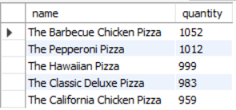
Some Analytical Queries
List the top 5 most ordered pizza types along with their quantities.

Slide 13
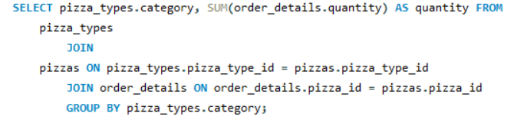
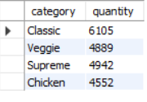
Some Analytical Queries
Join the necessary tables to find the total quantity of each pizza category ordered

Slide 14
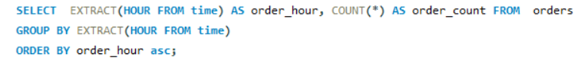
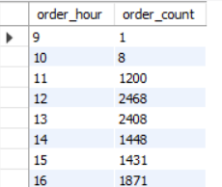
Some Analytical Queries
Determine the distribution of orders by hour of the day

Slide 15
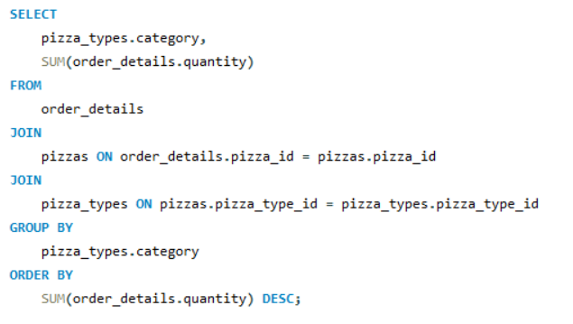
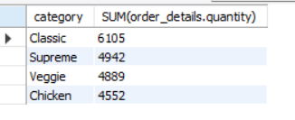
Some Analytical Queries
Join relevant tables to find the category-wise distribution of pizzas

Slide 16
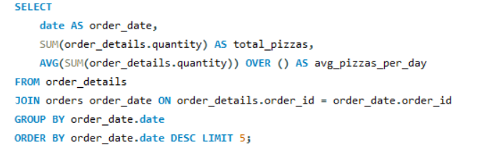
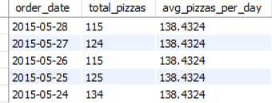
Some Analytical Queries
Group the orders by date and calculate the average number of pizzas ordered per day

Slide 17
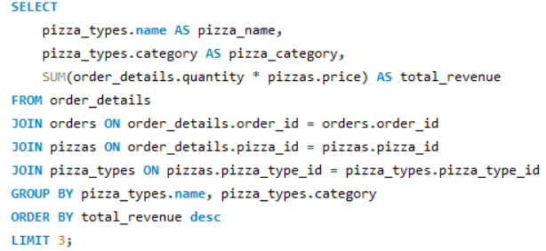
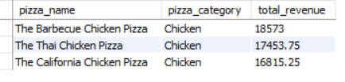
Some Analytical Queries
Determine the top 3 most ordered pizza types based on revenue

Slide 18
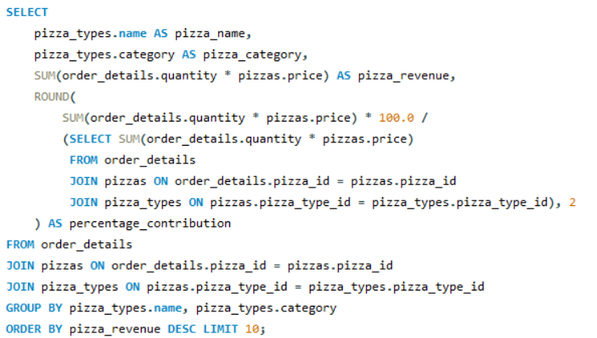
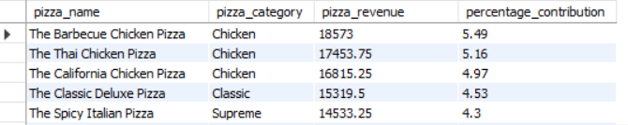
Some Analytical Queries
Calculate the percentage contribution of each pizza type to total revenue

Slide 19
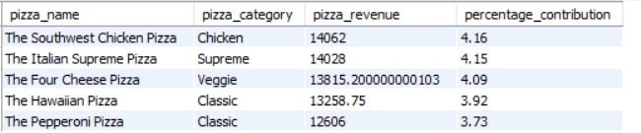
Some Analytical Queries
Calculate the percentage contribution of each pizza type to total revenue

Slide 20
THANK YOU

